Slide 1
CUDA programming (continue)
Acknowledgement: the lecture materials are based on the materials in NVIDIA teaching center CUDA course materials, including materials from Wisconsin (Negrut), North Carolina Charlotte (Wikinson/Li) and NCSA (Kindratenko).

Slide 2
Topics
CUDA C extensions
Implementing MM on GPU
Memory hierarchy
synchronization

Slide 3
CUDA C extensions
Declaration specifiers to indicate where things live
__global__ void mykernel(…) // kernel function on GPU
__device__ int globalVar; // variable in device
__shared__ int sharedVar; // in per block shared memory
Parallel kernel launch
Mykernel<<<500,128>>> (…); // launch 500 blocks with 128 threads each
Special variables
Dim3 threadIdx, blockIdx; // thread/block ID
Dim3 blockDim, gridDim; //thread/block size
Intrinsics for specific operations in kernel
__syncthreads(); // barrier synchronization

Slide 4
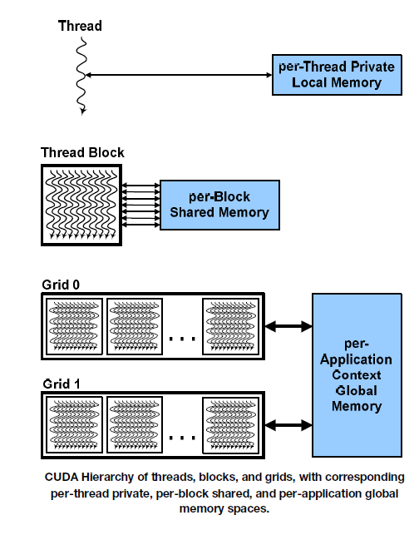
CUDA thread organization
hierarchy of threads
Blocks of threads in 1, 2, or 3 dimensions.
The collection of block is called a grid. Grids can be 1D or 2D.
The maximum number of threads inside each block, and the number of thread blocks in a grid is limited.

Slide 5
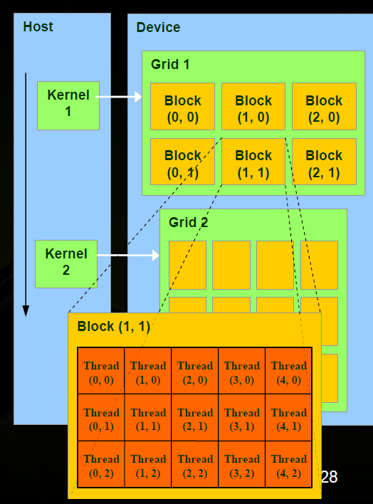
Cuda thread organization
Threads and blocks have IDs
So each thread can decide what data to work on.
Block ID (blockIdx): 1D, 2D – ID within a grid
Thread ID (threadIdx): 1D, 2D or 3D: ID within a block.

Slide 6
Device characteristics – hardware limitations
NVIDIA defined “compute capabilities” 1.0, 1.1, … with limits and features
Give the limits of threads per block, total number of blocks, etc.
Compute capability 1.0
Max number of threads per block = 512
Max sizes of x- and y-dimension of thread block = 512
Maximum size of each dimension of grid of thread blocks = 65535
Currently compute capability 4.0.
Can decide program parameters by querying the compute capability.

Slide 7
Specifying Grid/Block structure
The programmer need to provide each kernel call with:
Number of blocks in each dimension
Threads per block in each dimension
myKernel<<< B, T >>>(arg1, … );
B – a structure that defines the number of blocks in the grid in each dimension (1D or 2D).
T – a structure that defines the number of threads in a block in each dimension (1D, 2D, or 3D).
B and T are of type dim3 (uint3).

Slide 8
1-D grid and/or 1-D blocks
For 1-D structure, one can use an integer for each of B and T in:
myKernel<<< B, T >>>(arg1, … );
B – An integer would define a 1D grid of that size
T –An integer would define a 1D block of that size
myKernel<<< 1, 100 >>>(arg1, … );
Grids can be 2D and blocks can be 2D or 3D
struct dim3 {x; y; z;} threadIdx, blockIdx;
Grid/block size
Dim3 gridDim; size of grid dimension x, y (z not used)
Dim3 blockDim; - size of grid dimension,

Slide 9
Compute global 1-D thread ID
dim3
threadIdx.x -- “thread index” within block in “x” dimension
blockIdx.x -- “block index” within grid in “x” dimension
blockDim.x -- “block dimension” in “x” dimension (i.e. number of threads in a block in the x dimension)
Full global thread ID in x dimension can be computed by:
x = blockIdx.x * blockDim.x + threadIdx.x;
how to fix vecadd.cu to make it work for larger vectors? See vecadd1.cu. What is the right number of threads per block?

Slide 10
Compute global 1-D thread ID
Global ID 18
threadIdx.x
threadIdx.x
threadIdx.x
0
1
2
3
4
5
6
7
0
1
2
3
4
5
6
7
0
1
2
3
4
5
6
7
blockIdx.x = 0
blockIdx.x = 1
blockIdx.x = 2
gridDim = 3 x 1
blockDim = 8 x 1
Global thread ID = blockIdx.x * blockDim.x + threadIdx.x
= 2 * 8 + 2 = thread 18 with linear global addressing

Slide 11
1D grid/block examples
__global__ void vecadd(float* A, float* B, float* C)
{ int i = threadIdx.x; // threadIdx is a CUDA built-in variable
C[i] = A[i] + B[i];
}
Vecadd<<<1,n>>>( dev_A, dev_B, dev_C );
__global__ void vecadd(float* A, float* B, float* C)
{ int i = blockIdx.x * blockDim.x + threadIdx.x;
C[i] = A[i] + B[i];
}
vecadd<<<32,n/32>>>( dev_A, dev_B, dev_C );

Slide 12
Higher dimensional grids/blocks
Grids can be 2D and blocks can be 2D or 3D
struct dim3 {x; y; z;};
Grid/block size
Dim3 gridDim size of grid dimension x, y (z not used)
Dim3 blockDim - size of grid dimension,

Slide 13
2D grid/blocks
To set dimensions, use for example:
dim3 grid(16, 16); // Grid -- 16 x 16 blocks
dim3 block(32, 32); // Block -- 32 x 32 threads
myKernel<<<grid, block>>>(...);
which sets:
gridDim.x = 16
gridDim.y = 16
blockDim.x = 32
blockDim.y = 32
blockDim.z = 1

Slide 14
2-D grids and 2-D blocks
blockIdx.y * blockDim.y + threadIdx.y
threadID.y
threadID.x
blockIdx.x * blockDim.x + threadIdx.x

Slide 15
Flatten 2 dimension array into linear memory
Generally memory allocated dynamically on device (GPU) and we cannot not use two-dimensional indices (e.g. A[row][column]) to access array as we might otherwise.
Need to know how array is laid out in memory and then compute distance from the beginning of the array.
Row major and column major order storage of multi-dimensional arrays.

Slide 16
Flattening an array
Number of columns, N
column
0
N-1
0
Array element
a[row][column] = a[offset]
offset = column + row * N
where N is the number of items in a row
row
row * number of columns

Slide 17
2D grid/block example: matrix addition
#define N 2048 // size of arrays
__global__void addMatrix (int *a, int *b, int *c) {
int col = blockIdx.x*blockDim.x+threadIdx.x;
int row =blockIdx.y*blockDim.y+threadIdx.y;
int index = col + row * N;
if ( col < N && row < N) c[index]= a[index] + b[index];
}
int main() {
...
dim3 dimBlock (16,16);
dim3 dimGrid (N/dimBlock.x, N/dimBlock.y);
addMatrix<<<dimGrid, dimBlock>>>(devA, devB, devC);
…
}

Slide 18
Impact of the sizes of threads/block
See matrixmul.cu. Following is the execution trace: A warp can only contain threads in one block. We need at least 32 threads in one block!!
<gpu1:816> time ./a.out
3.318u 3.402s 0:06.85 97.9% 0+0k 0+0io 0pf+0w
<gpu1:817> time ./a.out 8
5.526u 3.200s 0:08.84 98.6% 0+0k 0+0io 0pf+0w
<gpu1:818> time ./a.out 4
18.193u 3.129s 0:21.41 99.5% 0+0k 0+0io 0pf+0w
<gpu1:819> time ./a.out 2
61.975u 3.227s 1:05.29 99.8% 0+0k 0+0io 0pf+0w
<gpu1:820> time ./a.out 1
231.894u 3.917s 3:55.94 99.9% 0+0k 0+0io 0pf+0w
<gpu1:821>

Slide 19
CUDA extension to declare kernel routines
__global__ indicates routine can only be called from host and only executed on device
__device__ indicates routine can only be called from device and only executed on device
__host__ indicates routine can only be called from host and only executed on host

Slide 20
Routine for device
__global__ routine must have a void return value.
Generally cannot call C library routines except CUDA built-in math routines such as sin, cos, etc.
Check NVIDIA CUDA programming guide for details.
CUDA also has device only routines.

Slide 21
Example for 2D grid/blocks
Matrix multiply:
for (i=0; i<N; i++)
for(j=0; j<K; j++)
for (k=0; k<M; k++)
c[i][j] += a[i][k] * b[k][j]
2D mesh must be stored in the linear (1D) array (column major order)
c[i][j] = c[i+N*j] = *(c+i+N*j);
a[i][k] = a[i+K*j] = *(a+i+K*k);

Slide 22
First cut
Using one thread to compute one c[i][j], a total of N*K threads will be needed.
N*K blocks of threads and 1 thread each block
See mm0.cu
// kernel MM routine
__global__ void mmkernel(float *a, float *b, float *c, int N, int M, int K)
{
int i = blockIdx.x, j = blockIdx.y;
float sum = 0.0f;
for (int k = 0; k< M; k++) sum += a[i+N*k] * b[k+K*j];
c [i+N*j] = sum;
}
dim3 dimBlock(1); dim3 dimGrid(N, N);
mmkernel<<<dimGrid, dimBlock>>> (dev_A, dev_B, dev_C, N, M, K);

Slide 23
Another try
See mm0_1.cu
// kernel MM routine
__global__ void mmkernel(float *a, float *b, float *c, int N, int M, int K)
{
int i = threadIdx.x, j = threadIdx.y;
float sum = 0.0f;
for (int k = 0; k< M; k++) sum += a[i+N*k] * b[k+K*j];
c [i+N*j] = sum;
}
dim3 dimBlock(1); dim3 dimGrid(N, K);
mmkernel<<<dimBlock, dimGrid>>> (dev_A, dev_B, dev_C, N, M, K);
Another thing wrong here?

Slide 24
Second try
Add threads to blocks to exploit the SIMT (SIMD) support
need to have at least 32 threads per block to have one 32 thread warp.
The more the better (GPU will have more options).

Slide 25
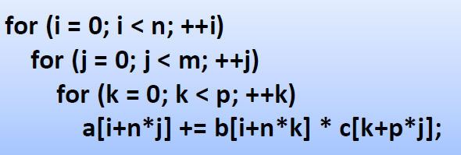

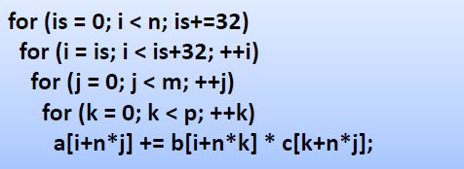
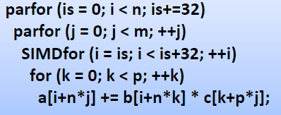

Slide 26
CPU and GPU memory
Mm with blocks of threads
__global__ void mmkernel(float *a, float *b, float *c, int N, int M, int K)
{
int i = blockIdx.x * BLOCK_SIZE + threadIdx.x, j = blockIdx.y;
float sum = 0.0f;
for (int k = 0; k< M; k++) sum += a[i+N*k] * b[k+K*j];
c [i+N*j] = sum;
}
dim3 dimBlock(BLOCK_SIZE);
dim3 dimGrid(N/BLOCK_SIZE, K);
mmkernel<<<dimGrid, dimBlock>>> (dev_A, dev_B, dev_C, N, M, K);
Notice the relationship between index calculation and kernel invocation.
Try mm1.cu with different BLOCK_SIZE’s

Slide 27
CUDA memory hierarchy
Thread
Register: per-thread basis
Private per thread
Can spill into local memory (perf. hit)
Shared Memory: per-block basis
Shared by threads of the same block
Used for: Inter-thread communication
Global Memory: per-application basis
Available for use to all threads
Used for: Inter-thread communication
Also used for inter-grid communication
Register
Block
Shared
Memory
Grid 0
Global
Device
Memory
. . .
Sequential
Grids
in Time
Grid 1
. . .
27

Slide 28
CUDA memory allocation
Memory Declaration Scope Lifetime
Registers Auto variables Thread Kernel
other than arrays
Local Auto arrays Thread Kernel
Shared __shared__ Block Kernel
Global __device__ Grid Application
Constant __constant__ Grid Application

Slide 29
An example
__global__ float A[1000];
__global__ void mmkernel(float *a, float *b, float *c, int N, int M, int K)
{
int i = blockIdx.x * BLOCK_SIZE + threadIdx.x;
int j = blockIdx.y;
int tx = threadIdx.x;
__shared__ float cb[BLOCK_SIZE];
int workb[BLOCK_SIZE];
……
}
Which type of variables are A, i, j, cb, workb?

Slide 30
MM with shared memory
In mm1.cu, threads use register variables and global arrays
A block of BLOCK_SIZE threads is used to compute: BLOCK_SIZE c items: c[0][0], c[1][0], c[2][0], …. C[BLOCK_SIZE][0]
The calculation:
C[0][0] = A[0][0] * B[0][0] + A[0][1]*B[1][0] + A[0][2] * B[2][0] …
C[1][0] = A[1][0] * B[0][0] + A[1][1]*B[1][0] + A[1][2] * B[2][0] …
C[2][0] = A[2][0] * B[0][0] + A[2][1]*B[1][0] + A[2][2] * B[2][0] …
A matrix has different values in different threads – can’t use shared memory
B matrix has the same items
Put B in shared memory may reduce the (global) memory traffic.
Shared memory in GPU is limited, can’t hold the whole column: need to reduce the memory footprint. How?
for(k=0; i<M; k++) C[i][j] += A[i][k]*B[k][j]

Slide 31
MM with shared memory
for(k=0; i<M; k++) C[i][j] += A[i][k]*B[k][j]
For (ks=0; ks < M; ks+=TSIZE)
for(k=ks; k<ks+TSIZE; k++) C[i][j] += A[i][k] * B[k][j];
For(ks=0; ks<M; ks+=TSIZE)
Forall (k=ks; k<ks+TSIZE; k++) workB[k][j] = B[k][j];
for (k=ks; k<ks+TSIZE;k++) C[i][j] += A[i][k] * workB[k][j];

Slide 32
MM with shared memory
__global__ void mmkernel(float *a, float *b, float *c, int N, int M, int K)
{
int i = blockIdx.x * BLOCK_SIZE + threadIdx.x;
int j = blockIdx.y;
int tx = threadIdx.x;
__shared__ float cb[BLOCK_SIZE];
float sum = 0.0f;
for (int ks = 0; ks < M; ks+= BLOCK_SIZE) {
cb[tx] = b[ks+tx+M*j]; // copy from global to shared, all threads parallel read
for (int k = ks; k< ks+BLOCKINGSIZE; k++) sum += a[i+N*k] * cb[k-ks];
}
c [i+N*j] = sum;
}
Any problem here?

Slide 33
MM with shared memory
__global__ void mmkernel(float *a, float *b, float *c, int N, int M, int K)
{
int i = blockIdx.x * BLOCK_SIZE + threadIdx.x;
int j = blockIdx.y;
int tx = threadIdx.x;
__shared__ float cb[BLOCK_SIZE];
float sum = 0.0f;
for (int ks = 0; ks < M; ks+= BLOCK_SIZE) {
cb[tx] = b[ks+tx+M*j]; // all BLOCK_SIZE threads parallel read
for (int k = ks; k< ks+BLOCKINGSIZE; k++) sum += a[i+N*k] * cb[k-ks];
}
c [i+N*j] = sum;
}
True dependence due to shared memory
Anti-dependence

Slide 34
MM with shared memory
__global__ void mmkernel(float *a, float *b, float *c, int N, int M, int K)
{
int i = blockIdx.x * BLOCK_SIZE + threadIdx.x;
int j = blockIdx.y;
int tx = threadIdx.x;
__shared__ float cb[BLOCK_SIZE];
float sum = 0.0f;
for (int ks = 0; ks < M; ks+= BLOCK_SIZE) {
cb[tx] = b[ks+tx+M*j]; // all BLOCK_SIZE threads parallel read
__syncthreads(); // barrier among all threads in a block
for (int k = ks; k< ks+BLOCKINGSIZE; k++) sum += a[i+N*k] * cb[k-ks];
__syncthreads(); // barrier among all threads in a block
}
c [i+N*j] = sum;
}
See mm2.cu

Slide 35
More schemes to improve MM performance
Compute multiple points in each threads
See mm3.cu
Using 2D block and 2D grid.

Slide 36
More information about __syncthreads()
All threads must reach the barrier before any thread can move on.
Threads arrives early must wait
__syncthreads() is kernel only.

Slide 37
More information about __syncthreads()
Only synchronize within a block.
Barriers in different blocks are independent.
Block 0
Block n-1
Barrier
Barrier
Continue
Continue
Separate barriers

Slide 38
More information about __syncthreads()
CUDA requires threads to synchronize using the exact the same __syncthreads() calls. Cannot do
if ... __syncthreads()
else … __syncthreads()
What if we want synchronize among all threads?
Make separate kernel invocations.

